Slide 1







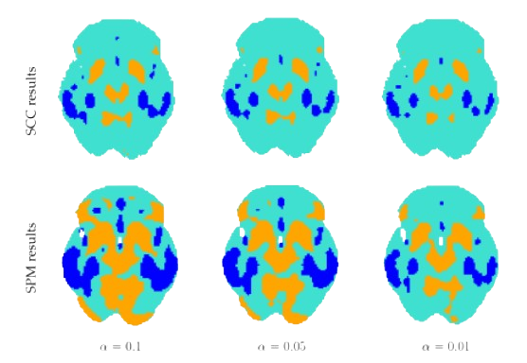
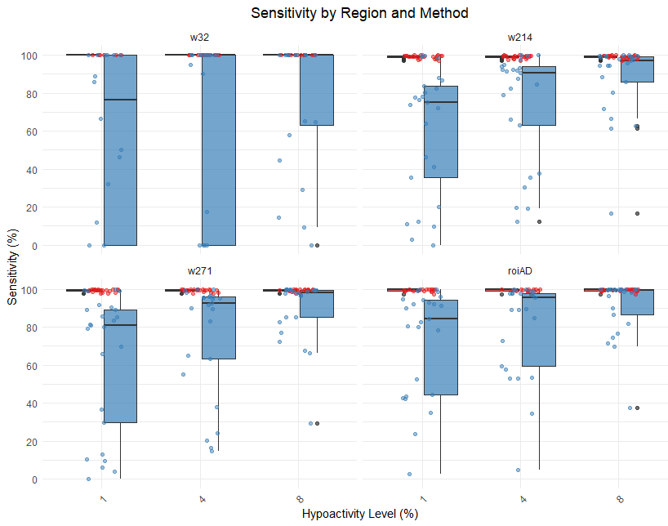
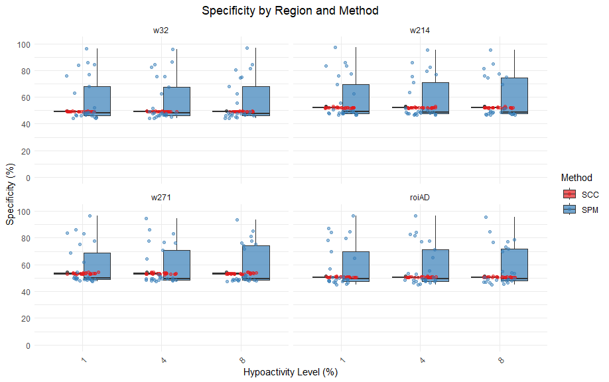
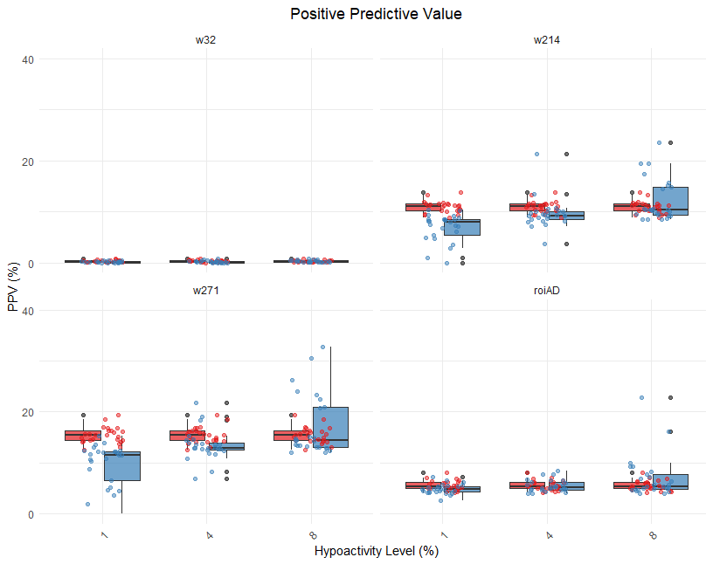
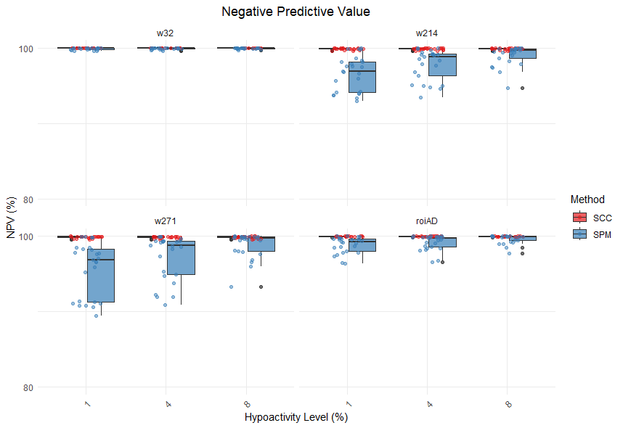

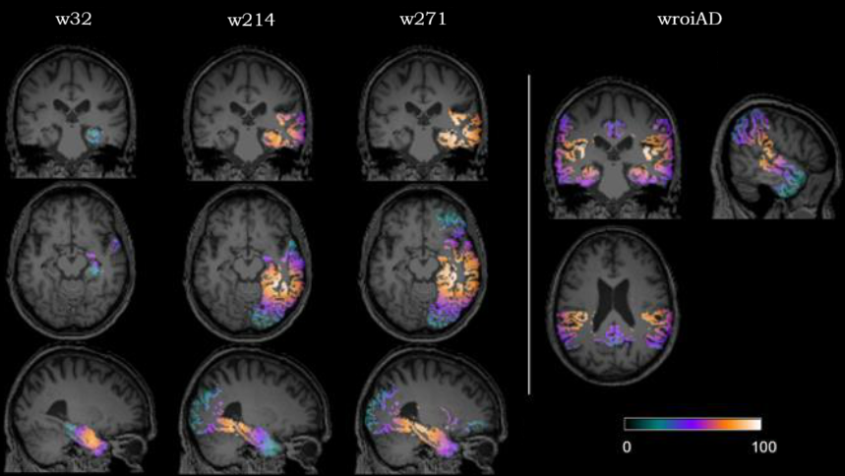

Functional Data Analysis versus Statistical Parametric Mapping: Single-Subject PET Analysis for Alzheimer's Disease Diagnosis
Juan A. Arias-López *^{1,2}, Carmen Cadarso-Suárez ^{1,2}, Pablo Aguiar-Fernández ^{3,4}, Andrew H. Kemp ⁵
1 INTRODUCTION
RESULTS 3
Analysis of group comparisons in neuroimaging data such as Positron Emission Tomography (PET) usually relies on mass univariate statistical analysis, which considers pixels as independent units for pixel-to-pixel comparisons using T-tests and Bonferroni's corrections. This approach, implemented in widely used software like Statistical Parametric Mapping (SPM), incurs in considerable detection errors derived from multiple comparison procedures.
Functional Data Analysis (FDA) techniques have recently emerged as a potential alternative [1]. Following this line of inquiry, our previous work [2, 3] has shown that FDA methods, applying bivariate splines over Delaunay triangulations to calculate Simultaneous Confidence Corridors (SCC), outperform SPM in group comparisons of brain activity (Figure 1). While these group-level results are promising, individual patient diagnosis is clinically more relevant. Using simulated data (Figure 2), we now evaluate SCC versus SPM performance in single-subject analysis for Alzheimer's Disease diagnosis.
To evaluate the performance of both methods in single-subject analysis, we assessed four efficiency metrics through boxplots: sensitivity, specificity, positive predictive value (PPV) and negative predictive value (NPV) (Figure 3). Each plot is divided into four sections representing the different brain regions assessed, with three columns per section showing results for different hypoactivity levels (10%, 40%, and 80%).
Results show that SCC consistently achieves higher sensitivity values than SPM across all regions and hypoactivity levels (Figure 3a). For specificity, SCC shows slightly lower but consistent values, while SPM presents more variable results with occasional cases of higher specificity in larger regions (Figure 3b). PPV analysis shows SCC performing better in mild and moderate hypoactivity levels, while SPM shows higher efficiency in severe cases, particularly in larger regions like w271 and w214 (Figure 3c). Finally, matching its high sensitivity, SCC exhibits consistently higher NPV levels than SPM across all conditions, though both methods maintain good performance in this metric (Figure 3d).
a)
b)
c)
d)
Figure 1: Comparison of SCC (top) and SPM (bottom) methods in detecting brain activity differences between groups using simulated data (example shown in Figure 2), at three significance levels (α = 0.1, 0.05, 0.01). Blue regions indicate hypoactivity and orange regions indicate hyperactivity. Our previous work demonstrated SCC's superior performance through both visual assessment and quantitative performance metrics.
2 METHODS AND DATA
Figure 3: Performance comparison between SCC (red) and SPM (blue) methods showing sensitivity (a), specificity (b), positive predictive value (c), and negative predictive value (d) across different brain regions and hypoactivity levels (10%, 40%, 80%).
In this project we evaluate this performance in single-subject diagnosis, comparing individual PET scans against a control group. The analysis uses simulated data (Figure 2) with known patterns of neural activity reduction across four brain regions (w32, w214, w271, and wroiAD) with increasing levels of simulated damage. Three levels of hypoactivity (10%, 40%, and 80%) were simulated for each region, resulting in 12 different analytical setups. The dataset comprises 325 PET scans: 25 controls and 300 patients (25 patients per setup). We compare SCC results with those obtained using classical SPM procedures under equal conditions.
CONCLUSIONS 4
These results confirm previous findings [3] on the advantages of SCC over established methods like SPM for individual patient diagnosis, especially in detecting small-extent damage and low hypoactivity levels - making it valuable for early diagnosis, the current clinical challenge. While SPM shows comparable performance with extensive and severe hypoactivity patterns, these cases are less relevant for early intervention. These findings suggest both the potential for improving neuroimaging analysis tools and broader applications to other neurological conditions.
REFERENCES 5
Wang, Y., Wang, G., Wang, L., & Ogden, R. T. (2020). Simultaneous confidence corridors for mean functions in functional data analysis of imaging data. Biometrics, 76(2), 427–437.
Arias-López, J. A., Cadarso-Suárez, C., & Aguiar-Fernández, P. (2022). Functional Data Analysis for Imaging Mean Function Estimation: Computing Times and Parameter Selection. Computers, 11(6), 91.
Arias-López, J. A., Cadarso-Suárez, C., & Aguiar-Fernández, P. (2022). Comparing Functional Data Analysis and Statistical Parametric Mapping with neuroimaging data [Poster presentation]. 31st International Biometric Conference, Riga, Latvia.
Figure 2: Examples of simulated brain regions (ROIs) with increasing spatial distribution of damage used for evaluation of both methods. Color intensity indicates levels of hypoactivity.
* CORRESPONDING AUTHOR:
juanantonio.arias.lopez@usc.es
juan-arias.xyz
Actividad financiada por el proyecto ED431C 2024/07
¹ Biomedical Data Science Unit, Department of Statistics, Mathematical Analysis, and Operational Research, Universidade de Santiago de Compostela
² CITMAga, 15782 Santiago de Compostela
³ Nuclear Medicine Department and Molecular Imaging Group, University Clinical Hospital and Health Research Institute of Santiago de Compostela (IDIS)
⁴ Molecular Imaging Group, Department of Psychiatry, Radiology and Public Health, Faculty of Medicine, Universidade de Santiago de Compostela
⁵ Department of Psychology, College of Human and Health Sciences, Swansea University, Swansea, UK

